Slide 1

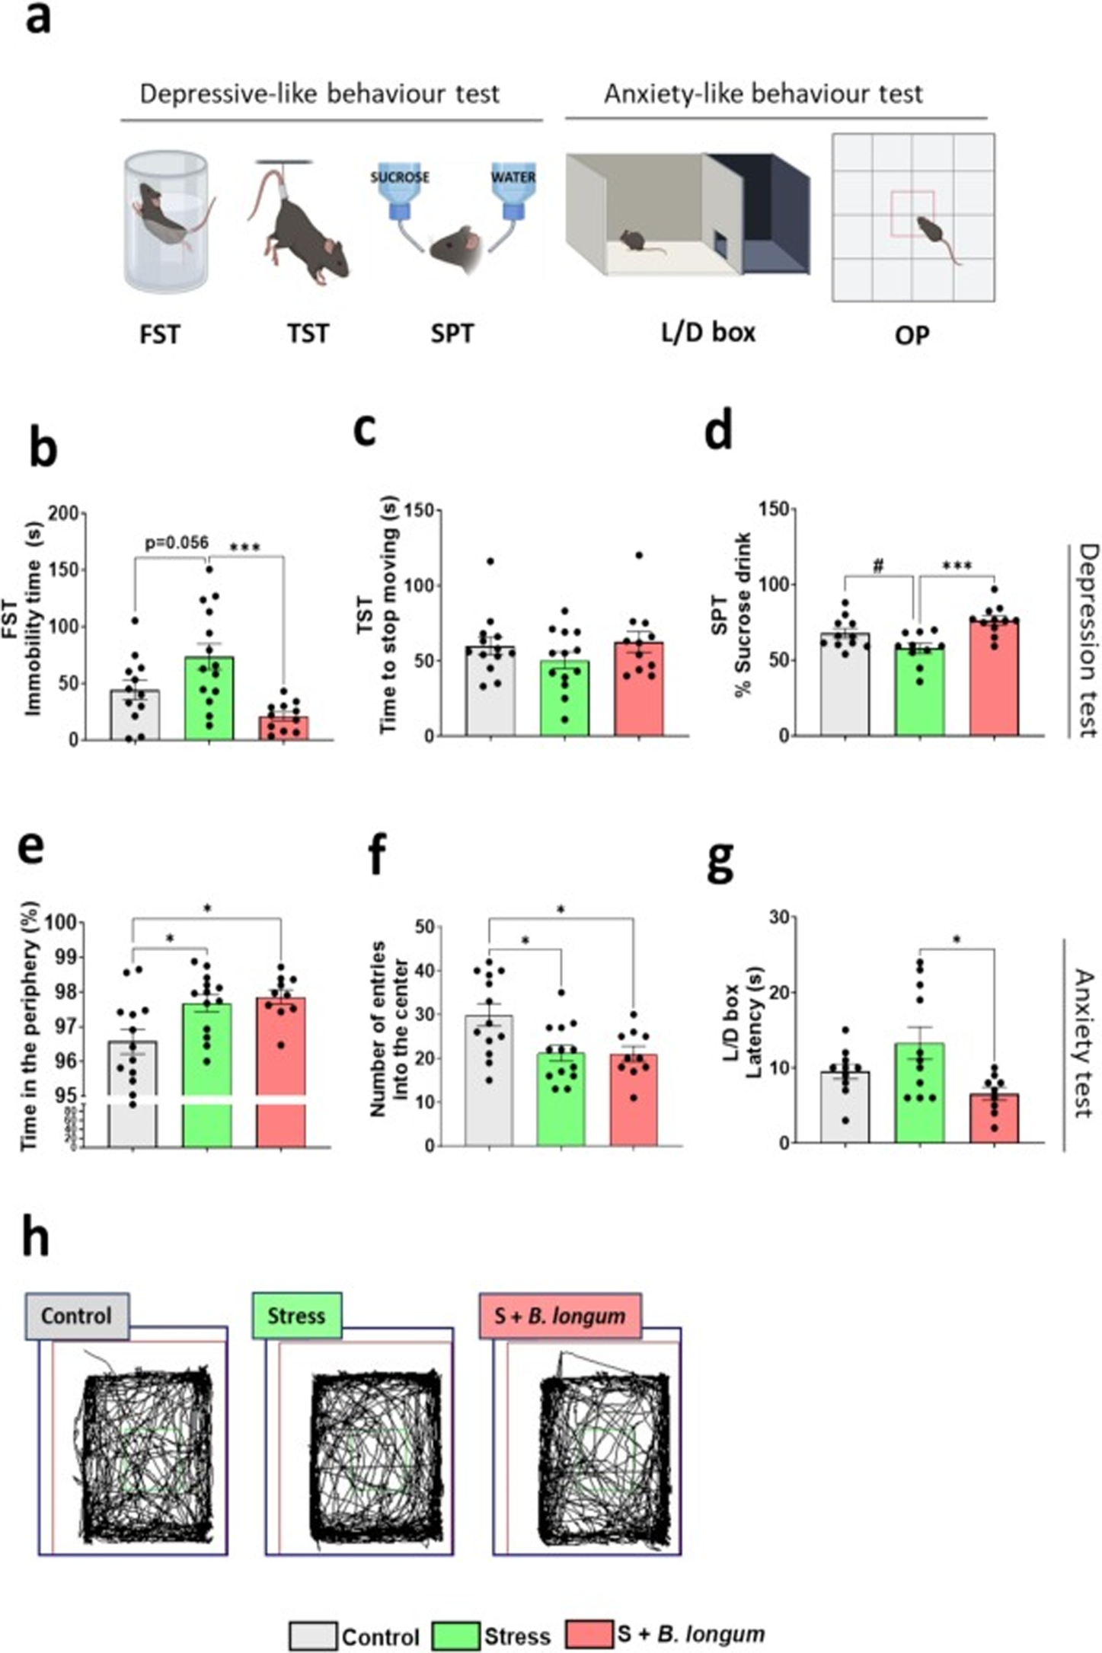
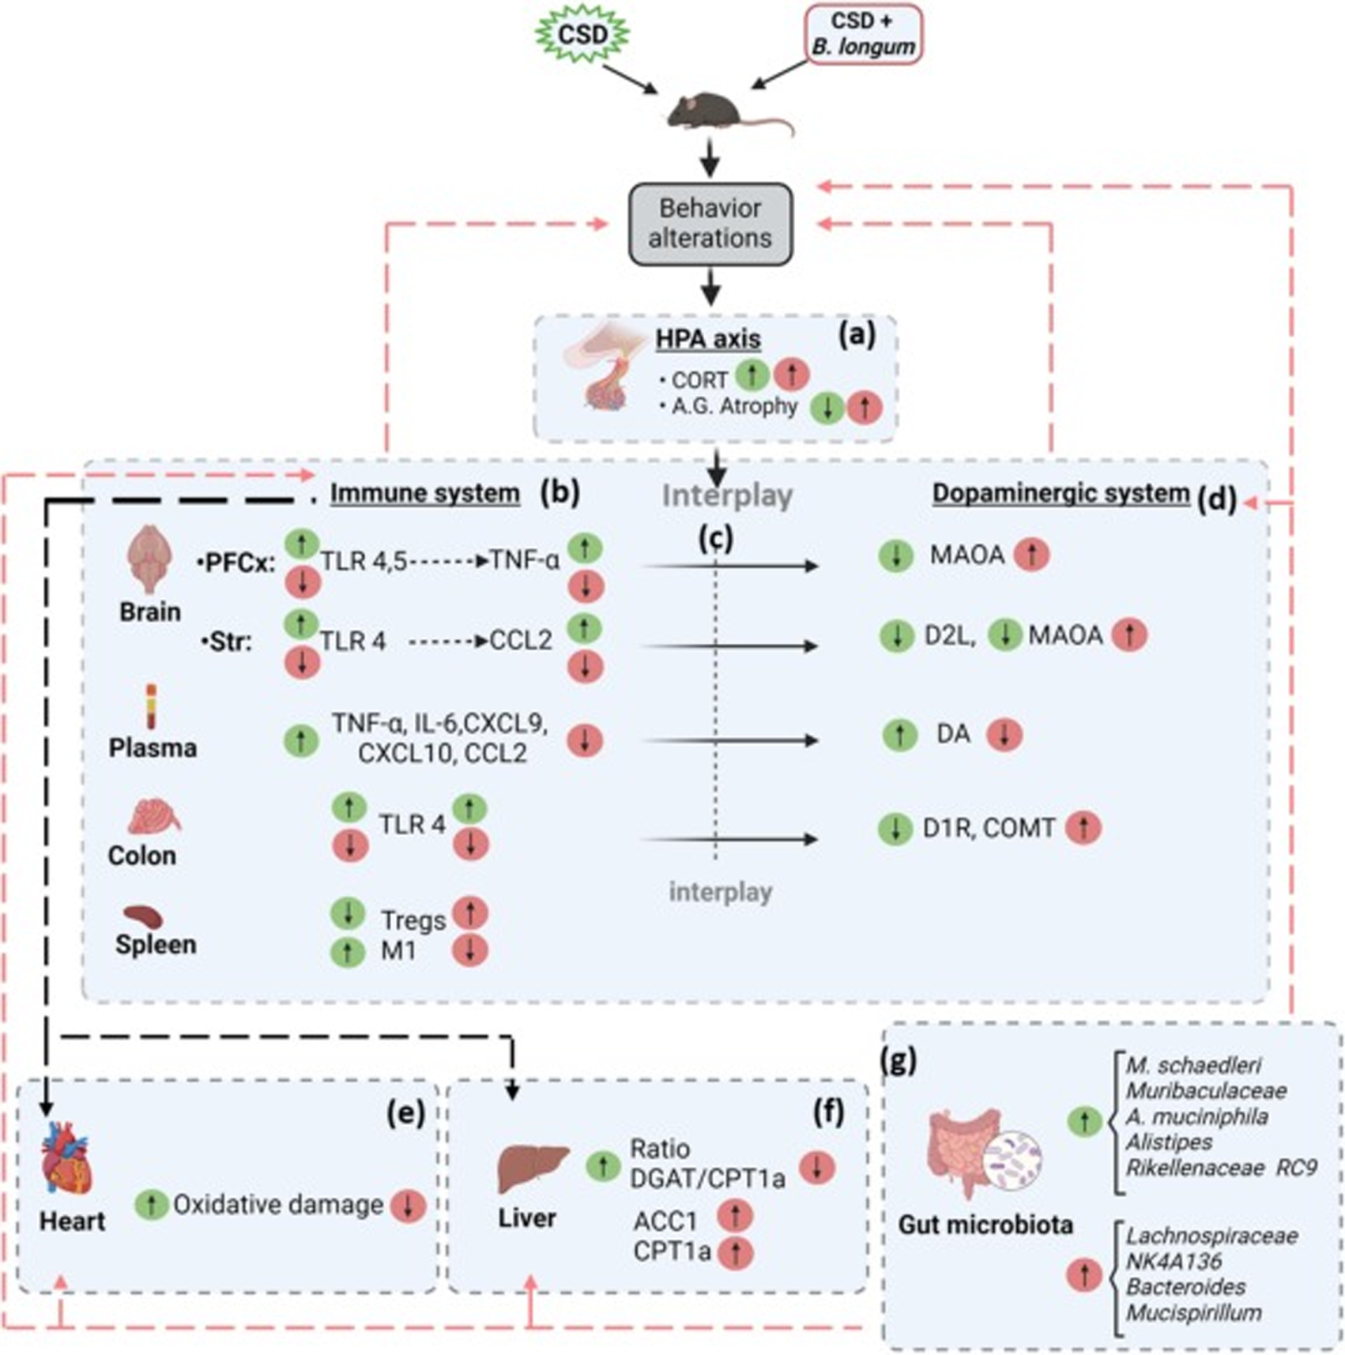
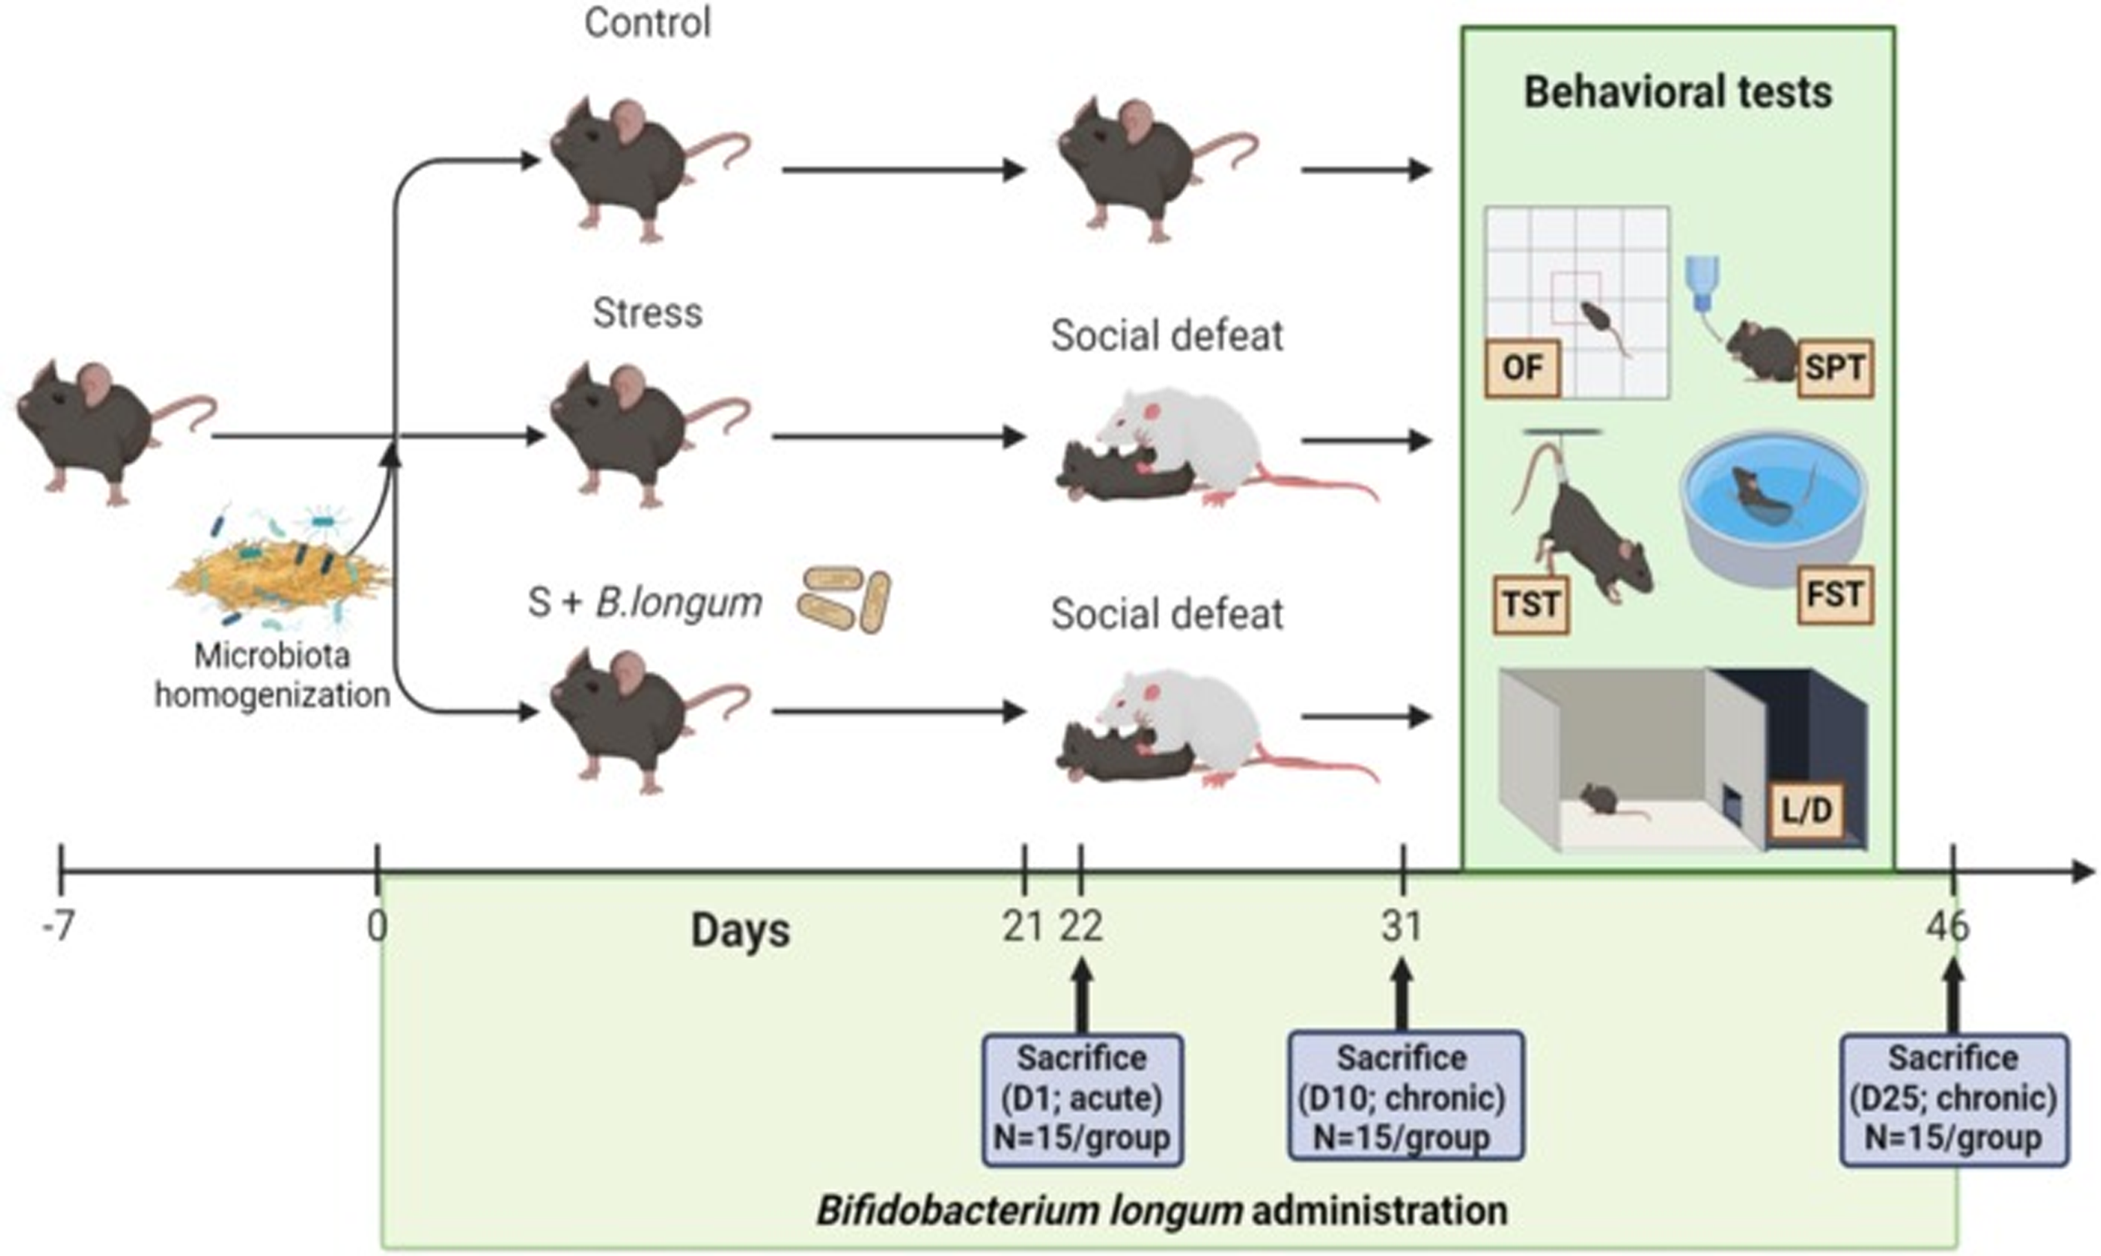



Bifidobacterium longum CECT 30763 Alleviates Mood Disorders in Stressed Mice via Immune and Dopamine Pathways
Tamayo M¹, Agustí A¹, Molina-Mendoza G. V¹, Rossini V¹, Tolosa-Enguís V¹, Olivares M¹, Medina E¹, Chiralt A², Guillamón JM³, Canals⁴, Sanz Y¹
1. Microbioma e Innovación en Nutrición y Salud. Instituto de Agroquímica y Tecnología de Alimentos (IATA-CSIC). Paterna (Valencia); 2. Instituto Universitario de Ingeniería de Alimentos-FoodUPV, Universitat Politècnica de València; 3. Biología de sistemas en levaduras de interés biotecnológico. IATA-CSIC. Paterna (Valencia); 4. Instituto de Neurociencias, CSIC, Alicante.
INTRODUCTION:
OBJECTIVE:
Depression is one of the leading causes of disability, morbidity, and mortality.
Unhealthy diets are the main risk factor for the development of chronic diseases.
The gut microbiota interacts with diet regulating immune, endocrine, and neuronal functions through the gut-brain axis contributing to human health.
Identification of novel compounds derived from by-products and probiotic bacteria with an antidepressant potential
Grape pomace exerts an bifidogenic effect associated with the reduction of pro-inflammatory citokines
Bifidobacterium longum CECT 30763 improves depressive- and anxiety-like behavior through the immune and dopaminergic systems
a
b
a
Blank
Positive control (glucose)
Grape pomace
Extract
Figure 1: Gut microbiota composition. Different superscript letters represent statistically diferences by ANOVA.
d
Figure 4: Effect of B. longum administration on depressive- and anxiety-like behavior in mice exposed to Chronic Social Defeat. Mean ± SEM. *p < 0.05, ***p < 0.001, #p < 0.05 (Student́s t test).
a
b
c
Figure 2: Gut microbiota metabolites. Different superscript letters represent statistically diferences by ANOVA.
Figure 6: Effects of B. longum on the immune and dopaminergic systems and scheme of the proposed mechanism through which B. longum functions as a psychobiotic.
a
b
c
Figure 3: Production of pro-inflammatory citokines and Pearson correlation. Different superscript letters represent statistically diferences by ANOVA.
MATERIAL AND METHODS
In vivo assays
In vitro assays
We have evaluated the immune properties and impact on the gut microbiota of fermented grape pomace from white grape varieties.
From the grape pomace, we also performed an extraction process using subcritical water (treatment here referred as "extract").
Collection of fecal samples
Fermentation
MICROBIOTA
METABOLITES
Glucose or the tested compounds
IMMUNE RESPONSE
We have demonstrated the potential of B. longum CECT 30763 to attenuate depressive and anxiety-like behaviours in the social defeat model. Further studies await to evaluate whether this effect can be achieved by the administration of grape pomade.
CONCLUSION

